Slide 1


Selection statements in Python
PROGRAMMING USING PYTHON
WEEK 03

Slide 2
CONTENTS
01
02
03
Introduction and types
If statement
If else statement
04
05
If elif else ladder
Nested if

Slide 3

SELECTION STRUCTURE
Need: In real life ,we need to make decisions and based on these decisions, we perform a set of actions. Similar situations arise in programming also where we need to make some decisions and based on these decisions we will execute a specific block of code.
Such process in a programming language is termed as Selection Structure.
Selection structures decides the direction of flow of program execution.
Selection Structure is also known as Decision Making Statements.

Slide 4
Selection Control Structures
if
if-else
if-elif-else ladder
Nested if-else

Slide 5
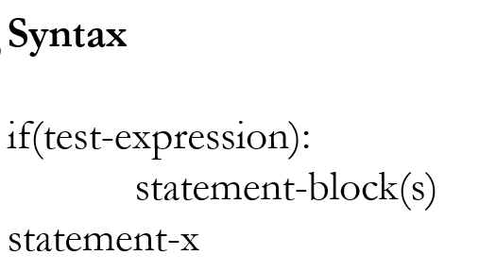
if statement
The if statement contains a logical expression using which data is compared and a decision is made based on the result of the comparison

Slide 6
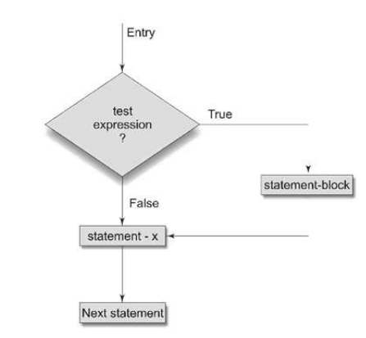
if statement
The program evaluates the test expression and will execute statement block only if the test expression is True.
If the test expression is false it will not execute the statement block.

Slide 7
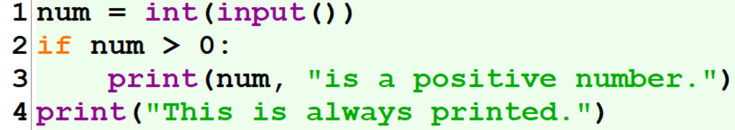
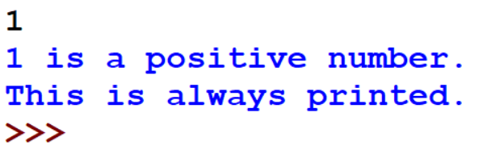
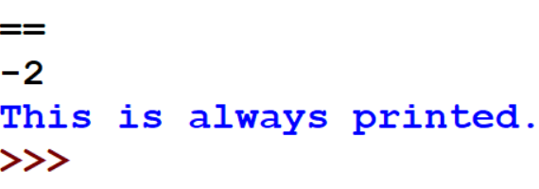
Example Programs

Slide 8
Example Programs
Program 1:
value = float(input("Enter the Bike Kilometeres:"))
if(value > 2500):
print("Need to Change Bike Oil")
print(“done”)
Program 2:
amount = float(input("Enter the amount:"))
if(amount > 40000):
print("Your Daily withdrawl amount exceeds the limit")
print(“done”)

Slide 9
if-else statement
A second form of the if statement is ‚alternative execution, in which there are two possibilities and the condition determines which one runs.
If the conditional expression in the if statement is TRUE then the if block of code get executed.
An if the conditional expression in the if statement is FALSE then the else block of code gets executed.
There can be at most only one else statement following if.

Slide 10
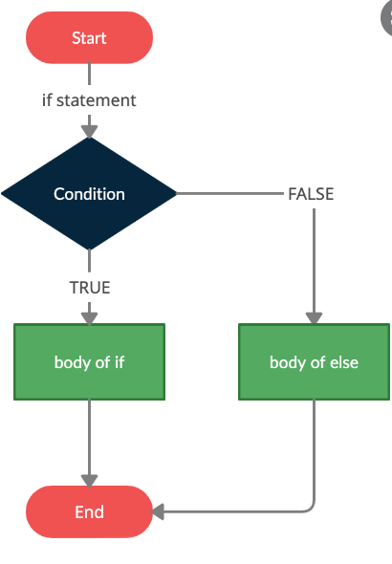
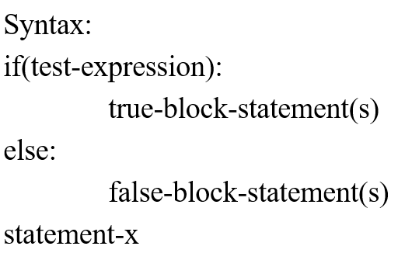
if-else statement

Slide 11
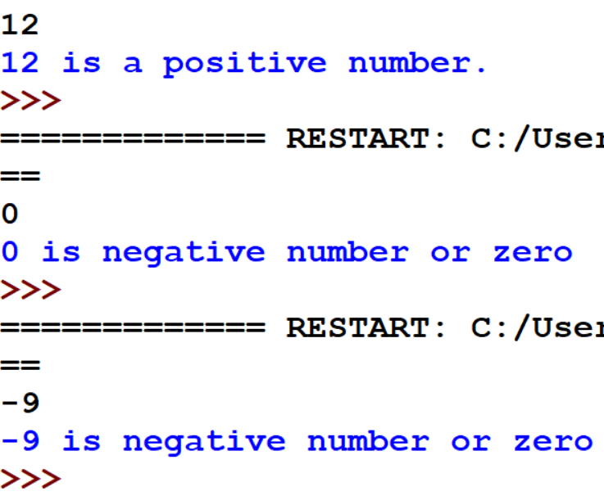
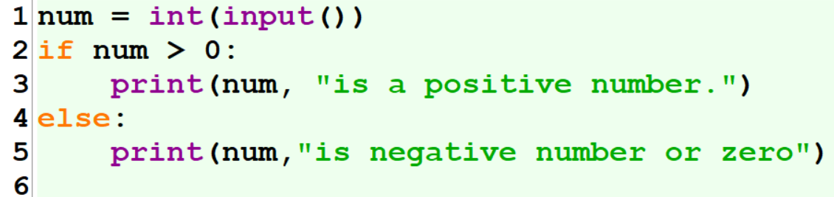
Example Programs

Slide 12
Example Programs
Program 1:
value = float(input("Enter the Bike Kilometeres:"))
if(value > 2500):
print("Need to Change Bike Oil")
else:
print(“Can drive”)
Program 2:
amount = float(input("Enter the amount:"))
if(amount > 40000):
print("Your Daily withdrawl amount exceeds the limit")
else:
print(“Withdraw”)

Slide 13
if-elif-else statement
Sometimes there will be a necessity to evaluate more than one condition to make a decision. One way to express a computation like that is a chained conditional.
The elif statement allows you to check multiple expressions for TRUE and execute a block of code as soon as one of the conditions evaluates to TRUE.

Slide 14
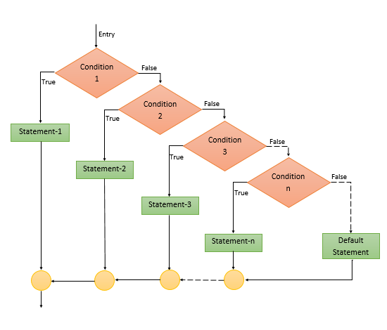
If-elif-else statement
Syntax
if(test-condition-1):
statement-1
elif(test-condition-2):
statement-2
. . .
. . .
elif(test-condition-n):
statement-n
else:
default-statement
statement-x

Slide 15
If-elif-else statement
The elif is short for else if. It allows us to check for multiple expressions.
If the condition for if is False, it checks the condition of the next elif block and so on.
If all the conditions are False, the body of else is executed.
Only one block among the several if...elif...else blocks is executed according to the condition.
The if block can have only one else block. But it can have multiple elif blocks.

Slide 16
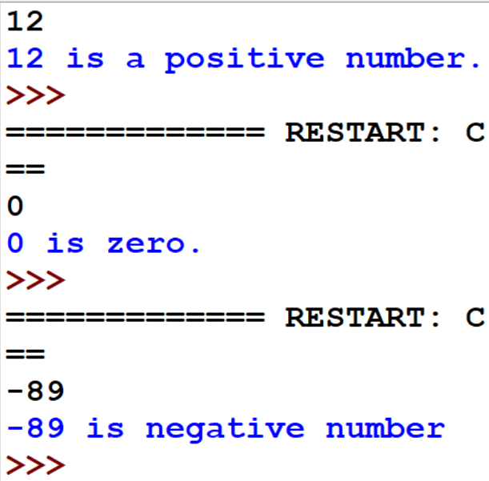
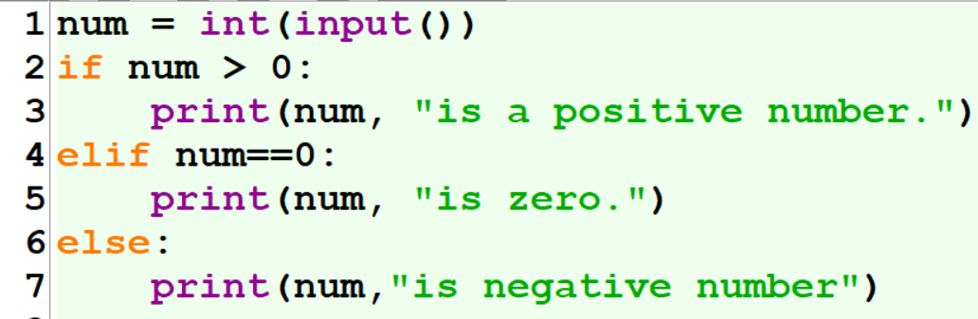
Example Programs

Slide 17
Nested if statement
There may be a situation when you want to check for another condition after a condition resolves to true. In such a situation, you can use the nested if construct.
Any kind of selection structure can be nested within another selection structure.
In the given syntax we will show one particular example.

Slide 18
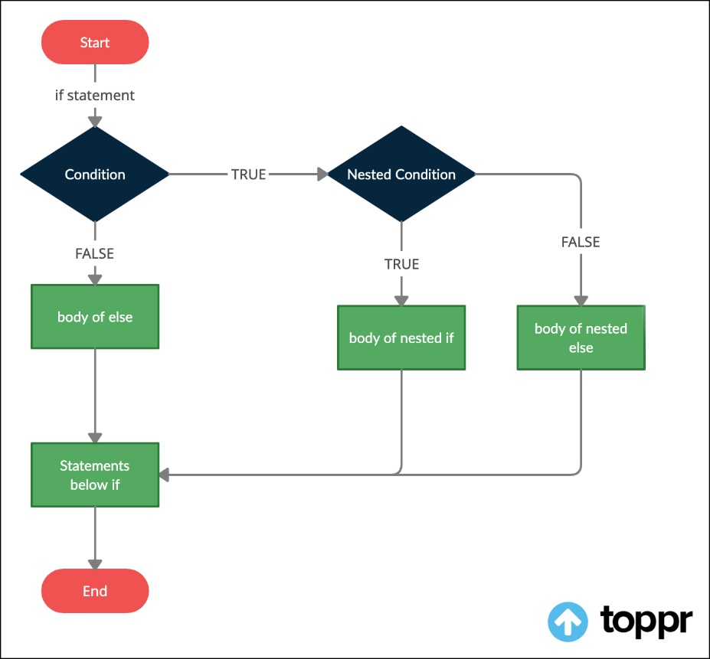
Nested if statement
Syntax
if(test-condition-1):
if(test-condition-2):
statement-1
else:
statement-2
else:
statement-3
statement-x

Slide 19
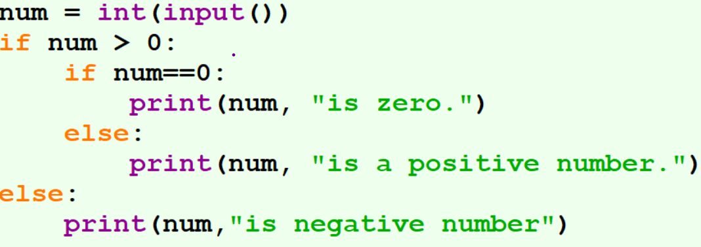
Example Programs

Slide 20
Programs to be solved
A toy vendor supplies three types of toys: Battery Based Toys, Key-based Toys, and Electrical Charging Based Toys. The vendor gives a discount of 10% on orders for battery-based toys if the order is for more than Rs. 1000. On orders of more than Rs. 100 for key-based toys, a discount of 5% is given, and a discount of 10% is given on orders for electrical charging based toys of value more than Rs. 500. Assume that the numeric codes 1,2 and 3 are used for battery based toys, key-based toys, and electrical charging based toys respectively. Write a program that reads the product code and the order amount and prints out the net amount that the customer is required to pay after the discount.

Slide 21
Programs to be solved
Write a python program to find the greatest of three numbers

Slide 22
Programs to be solved
A function f is defined as follows :
f(x) = ax³ – bx² + cx –d, if x > k
= 0, if x = k
= -ax³ + bx² – cx +d, if x < k
Write a program that reads a, b, c, d, k and x and prints the value of f(x).

Slide 23
Programs to be solved
Read any two positive integer numbers (say n1 & n2) and one character type operator (say opr). Note that opr is any mathematical operator.
Depending upon the operator, do the appropriate operation. e. g. if opr is ‘+’ then the display the value obtained by evaluating the expression (n1 + n2).

Slide 24
Programs to be solved
A transport company charges the fare according to following table:
Distance Charges
1-50 8 Rs./Km
51-100 10 Rs./Km
> 100 12 Rs/Km
Ask user to enter the distance and compute the fare.

Slide 25
Programs to be solved
Find whether the given number is of one digited or two digited or three digited or more than three digited.

